Slide 1
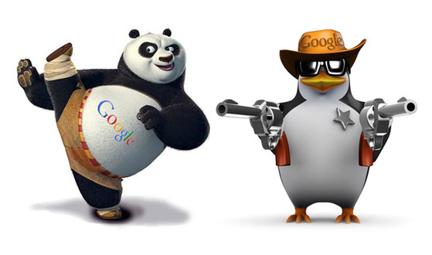
Topic 2 : Google Panda and Penguin
ST2228 WEB AND MOBILE
ANALYTICS

Slide 2
Learning Objectives
Who is Google Panda?
What does “Panda” like?
How to keep a “Panda” happy?
What happen when “Panda” strikes?
Have you been bitten by a “Panda”?
How to spot “Panda”?

Slide 3
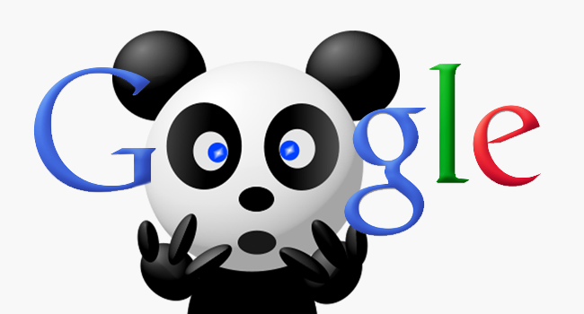
Who is Google Panda?

Slide 4
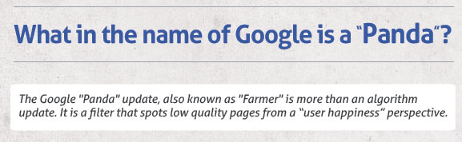
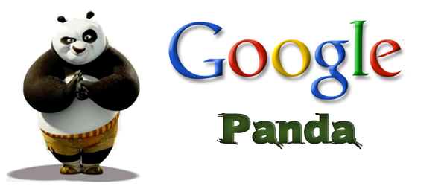
Who is Google Panda?

Slide 5
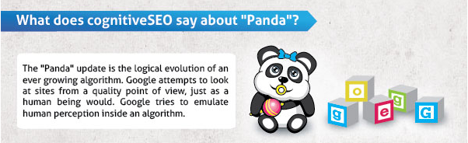
Who is Google Panda?

Slide 6
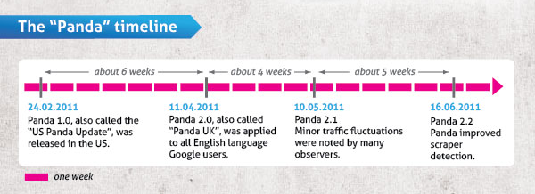
Who is Google Panda?

Slide 7
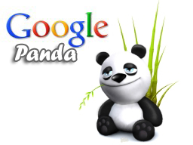
What does “Panda” like?

Slide 8
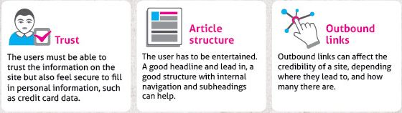
What does “Panda” like?

Slide 9
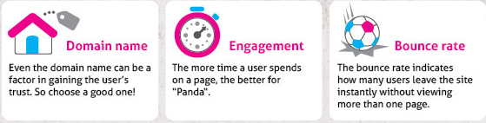
What does “Panda” like?

Slide 10
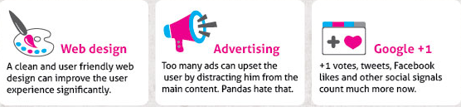
What does “Panda” like?

Slide 11
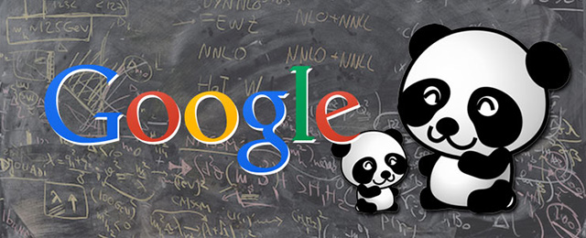
How to keep a “Panda” happy?

Slide 12
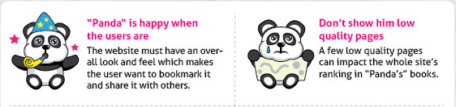
How to keep a “Panda” happy?

Slide 13
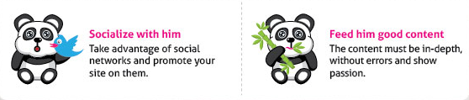
How to keep a “Panda” happy?

Slide 14

What happen when “Panda” strikes?

Slide 15
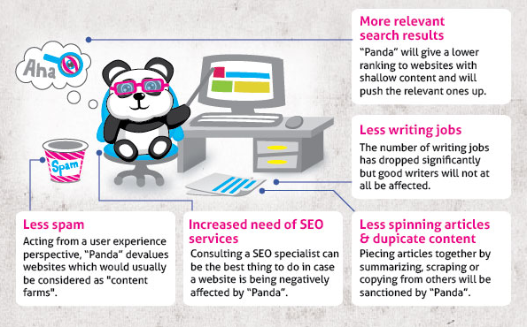
What happen when “Panda” strikes?

Slide 16
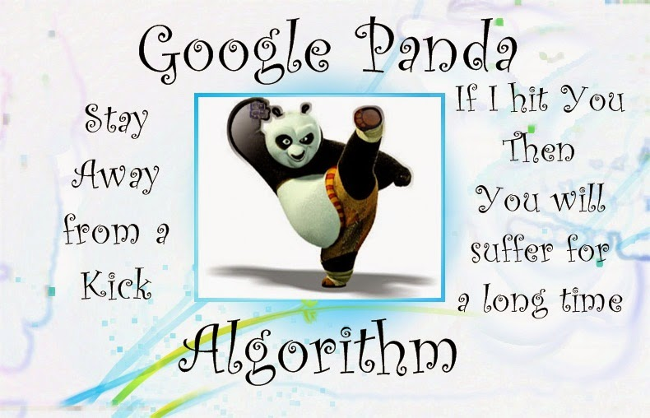
Have you been bitten by a “Panda”?

Slide 17
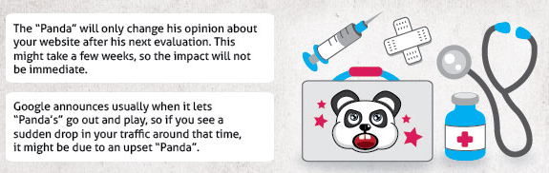
Have you been bitten by a “Panda”?

Slide 18
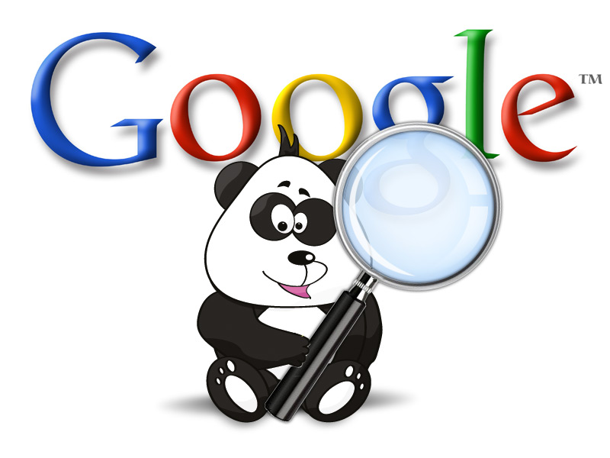
How to spot “Panda”?

Slide 19
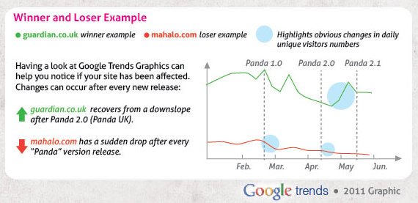
How to spot “Panda”?

Slide 20
References
What in the name of Google is a “Panda” – infographic, Razan Gavrilas, CognitiveSEO, http://cognitiveseo.com/blog/80/what-in-the-name-of-google-is-a-panda-infographic/
Google Panda – simple and cute explainer video, VSI group, https://www.youtube.com/watch?v=vTNFf_tUjTA

